Slide 1


Spring Cloud Data Flow
An Overview
Notes:
Cloud native, data orchestration toolkit to build data pipelines
Process in real time.
Microservice based, real time , stream processing product
Predesssor of Spring XD

Slide 2
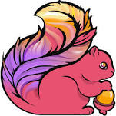
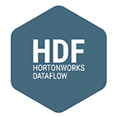
Spring Cloud Data Flow vs Competitors
Apache Flink
Google Data Flow
Hortonworks Data Flow
Notes:
Other products run on dedicated cluster and uses their own Resource manager to control the resources.
SCDF :
leverages the rise of the cluster resource managers such as YARN/Mesos/Kubernetes/Cloud Foundry and share the cluster with other distributed applications.
Bind the messaging bus (RMQ/Kafka/Google PubSub/AWS Kinesis/)
Advantage of SCDF:
Fault Tolerant, High scalability and portability

Slide 3
What is Spring Cloud Data Flow Used For?
Next-Gen Data Workloads
IoT, Machine Learning
Event Stream Processing
Integration
Messaging
Batch, DBMS, files
Modernization
and
Replatforming
Notes:
No matter where your business is today in its transformation to digital,
Spring Cloud Data Flow offers developers a place to start working with data.
Use cases:
From replacing how you move data between existing systems,
to setting up scalable endpoints for ingesting new data streams,
to operationalizing machine learning models for real time decisions.
The common underlying Spring Boot microservices architecture
means that learning can be shared and developers can iterate quickly.

Slide 4
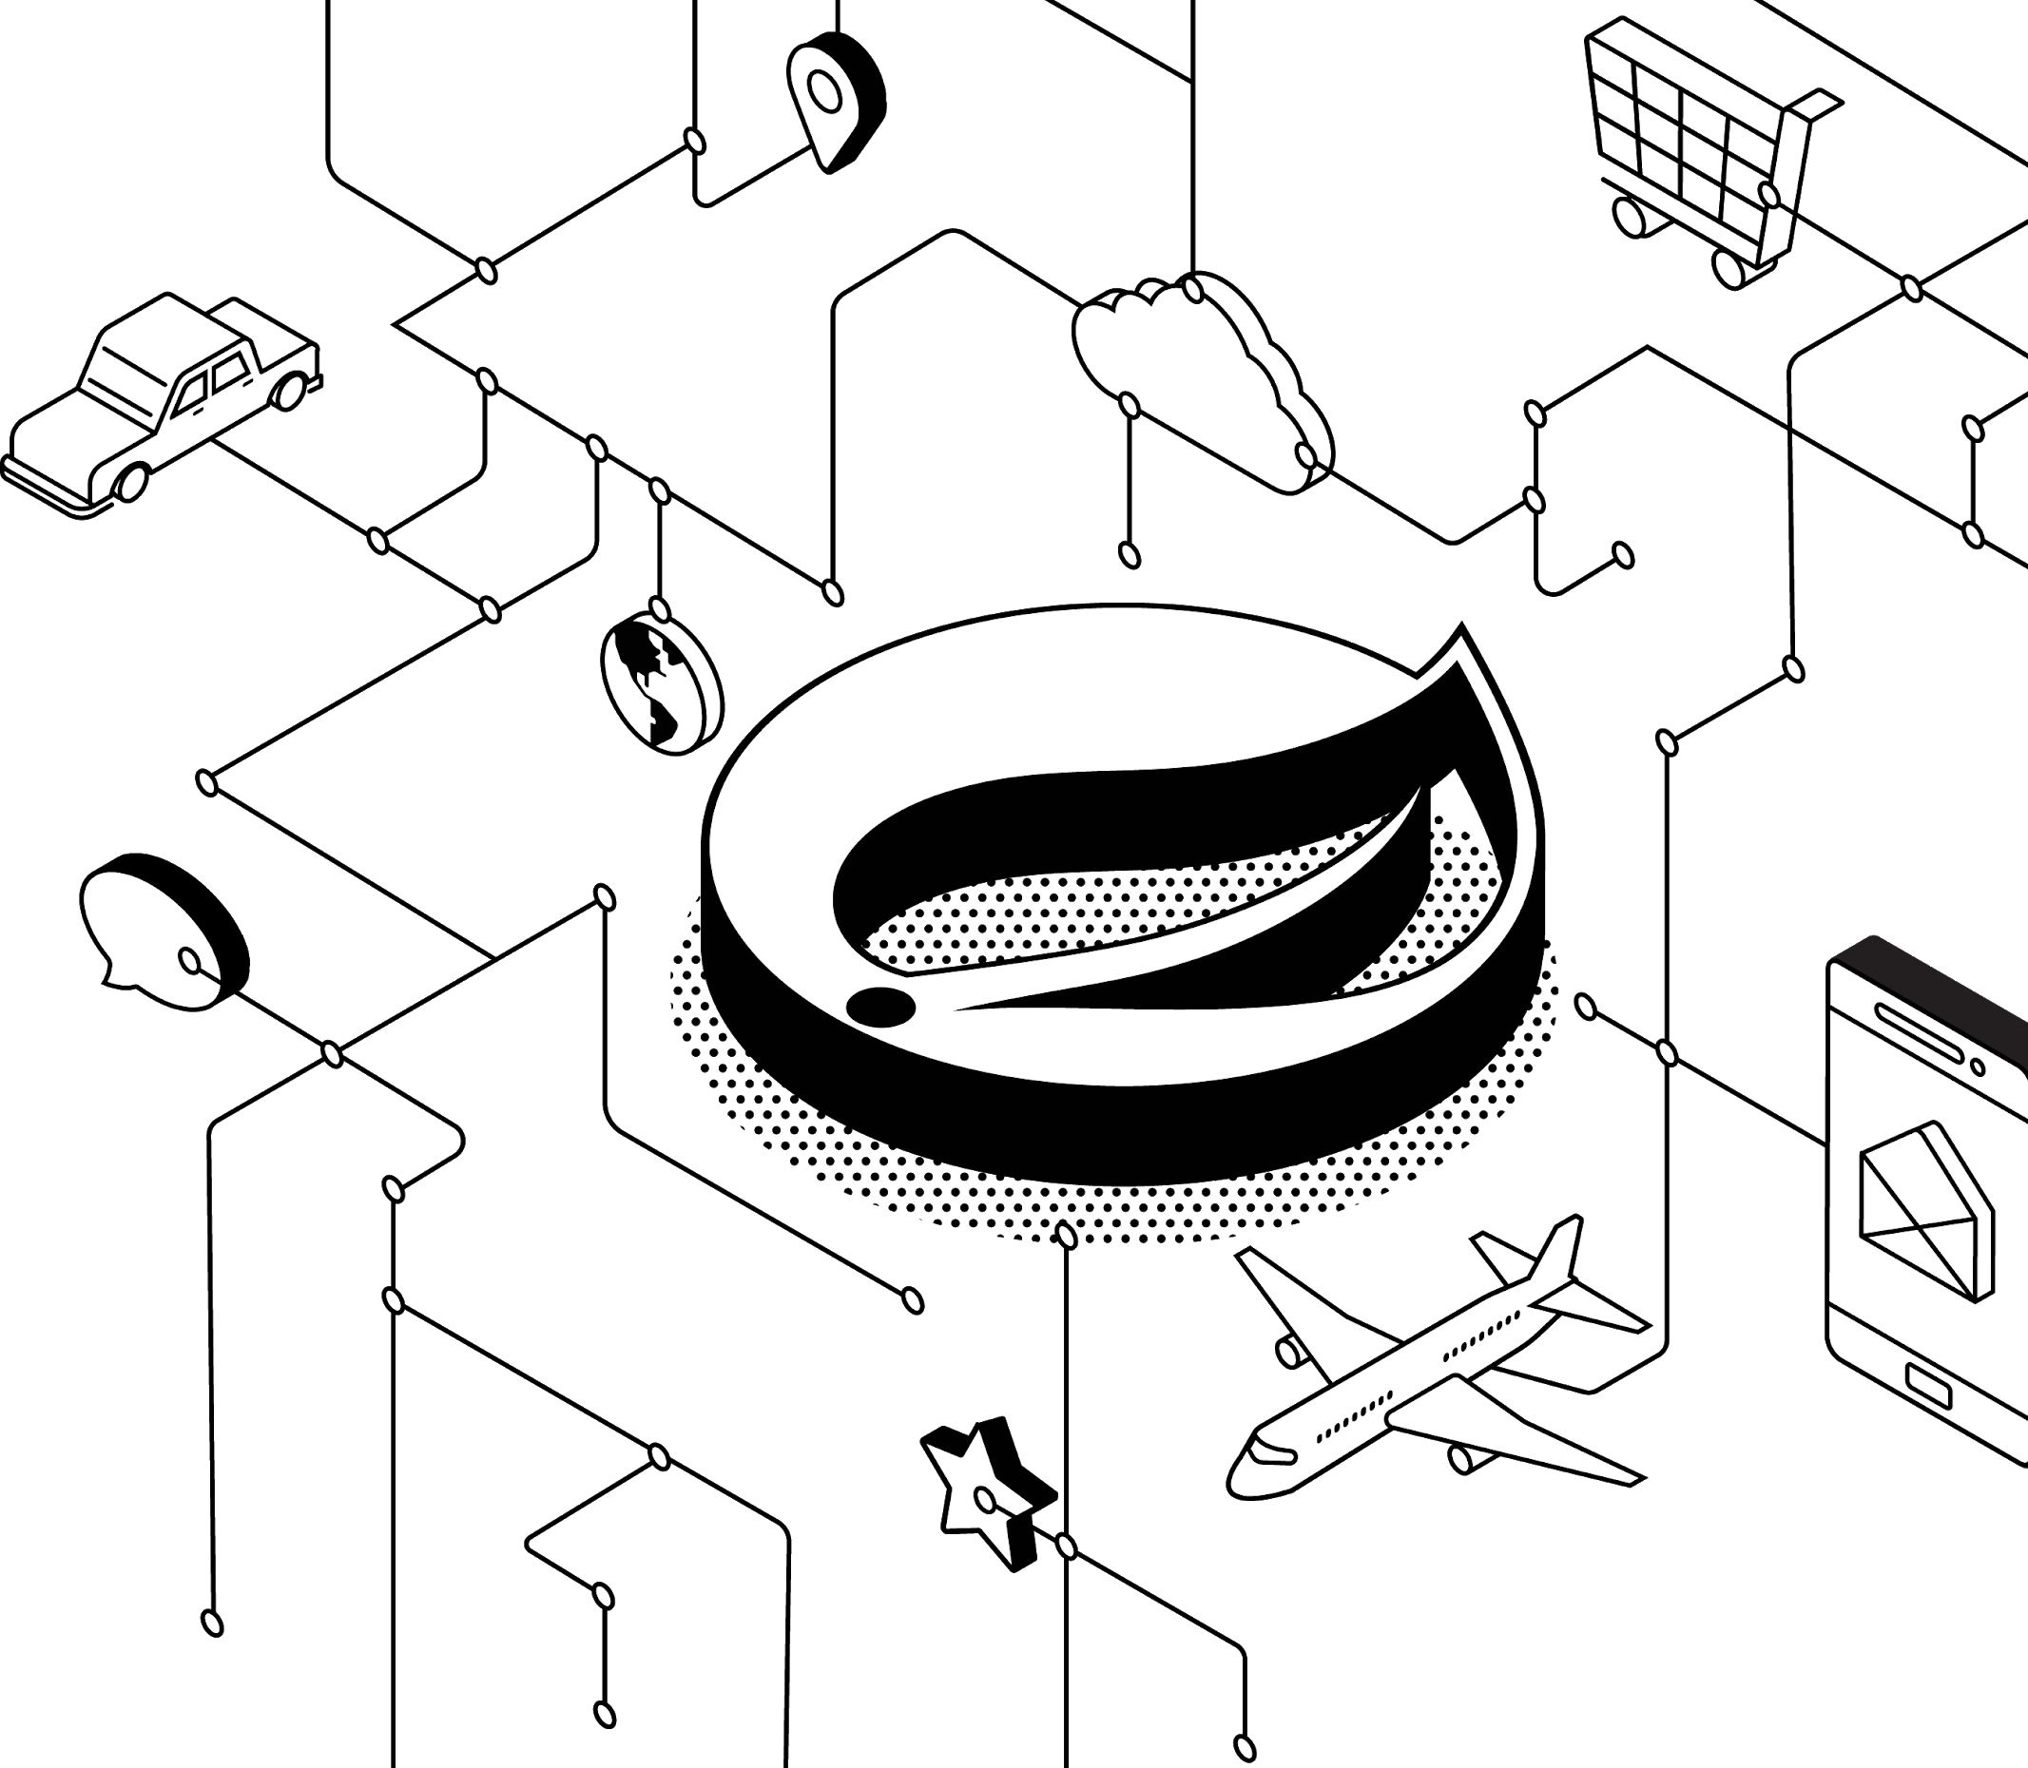
Trends
Enterprises are adopting DevOps practices in their transition into software and data-driven businesses.
ETL integration with existing systems, and modernization efforts are still very important.
Continuous Event processing is becoming mainstream.
Organizations are finding new ways to integrate IoT data flows and Machine Learning.
Notes:
In addition to devOps for applications, adopting CI/CD for data pipelines
ETLs run on bare metal, no fault tolerant or scaling. Legacy ETLs needs to be modernized to cloud native data pipelines
IoT devices, Time to market, fraud detection is becoming important. Real time processing with
High Volume, Velocity is needed.

Slide 5
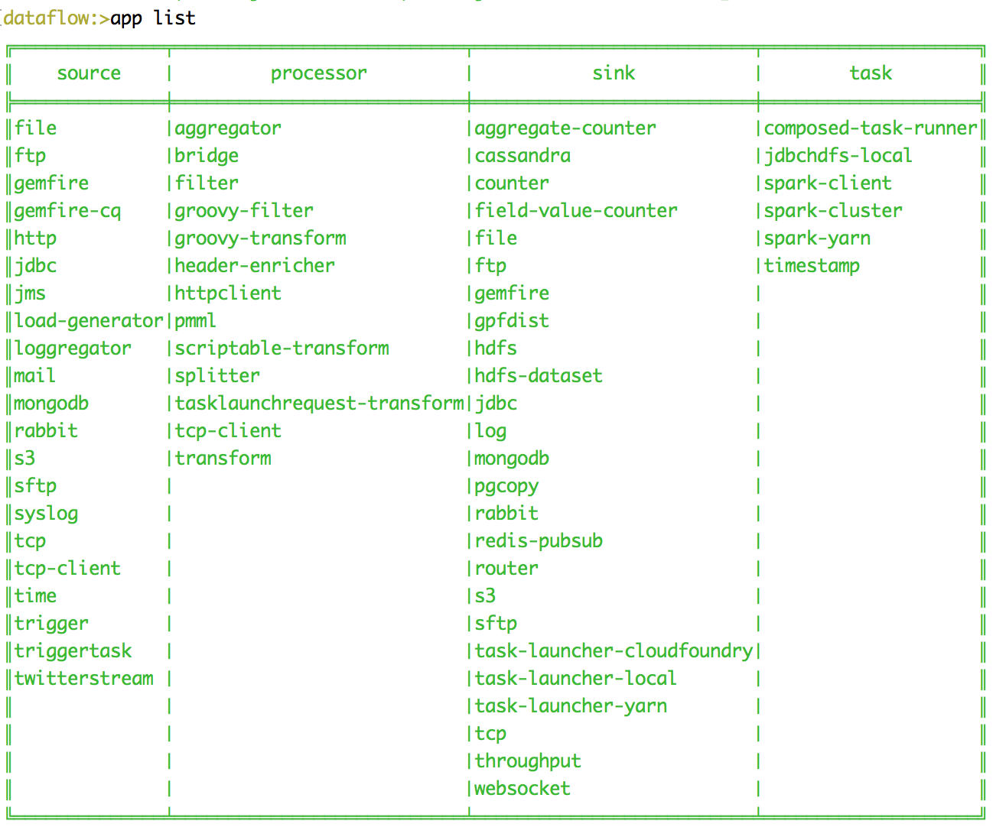
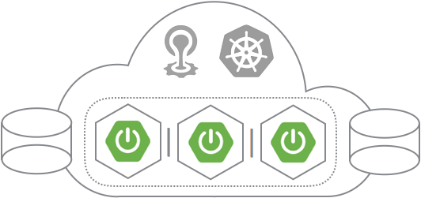
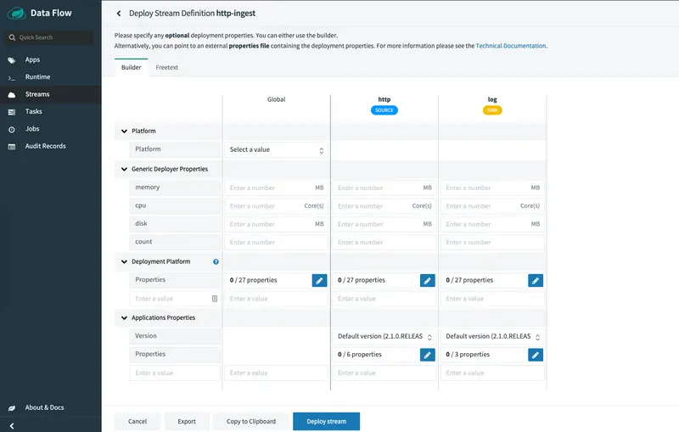
What Is Spring Cloud Data Flow
Spring Cloud Data Flow is a Microservices toolkit for building data pipelines.
Pipelines consist of Spring Boot apps, Spring Cloud Stream events or Spring Cloud Task processes.
The Data Flow server provides interfaces to compose and deploy pipelines onto Tanzu.
Notes:
Build data pipelines using Sources, Processors and Sinks
It provides
Dashboard
Shell
Runtime - PCF, Kubernetes, Mesos, Yarn
Formula : Source | (processor) n | (Sink) n

Slide 6
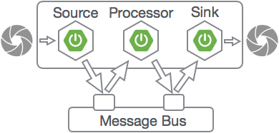
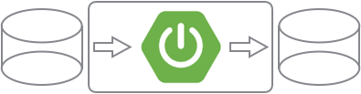
Microservices Are Not Just For REST & Web Apps
Spring Cloud Task Tasks are finite Boot Microservices. They connect to data/storage. The system tracks invocations, exit-status
Useful for ETL e.g. between DBMS and analytics clusters like Hadoop
Spring Cloud Stream Message based Microservices. Loose coupling via pub/sub topics. Pluggable message bus Kafka or RabbitMQ
For integration and stream processing
Notes:
Microservices are not just for REST services and Web apps.
They can also be used as components in batch processing and stream processing pipelines.
Spring Cloud Task enables Batch-Integration Microservices by providing Spring developers with a Task abstraction.
Tasks are simple processes
They start, do some some work by connecting to databases or file storage, and then they finish.
Tasks can be composed by chaining them together in series, or running them in parallel.
Spring Cloud Stream enables Messaging Microservices by providing Spring developers with Stream abstractions.
Stream processing apps "bind" to topics on a message bus like RabbitMQ or Kafka,
They publish or subscribe to events flowing through that topic.
The pub/sub contract is useful because it decouples message consumers from producers.
Each stage in the pipeline can be independently scaled.
Besides serving as a model for data integration, Streaming Microservices form the basis for building Next-Gen Real-time Streaming Applications.

Slide 7
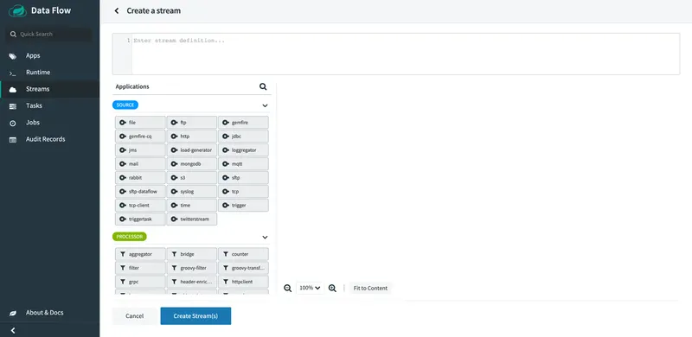
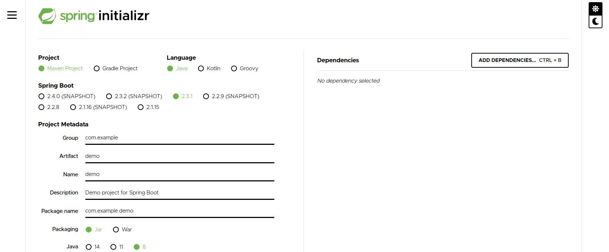
Don’t Start From Scratch
Choose from one of the App Starters, or generate a custom project using the Spring Initializr.

Slide 8
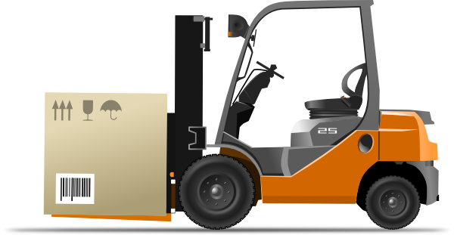
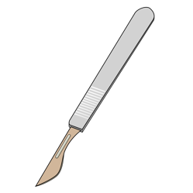
Replatforming
Modernization
Move Java applications running integration workloads
From App servers on dedicated bare-metal hosts or VMs
To event-driven, or on-demand task oriented Java Microservices, deployed on a Cloud Native platform.
Refactor Monolithic ETL workloads
Migrate SQL stored procedures
Rewrite Shell scripts
From EAI and ESB servers
To Java Microservices, deployed on a Cloud Native platform.
µService
SQL EAI/ESB
APP
APP
APP
APP
APP
µService
APP
APP
µService

Slide 9

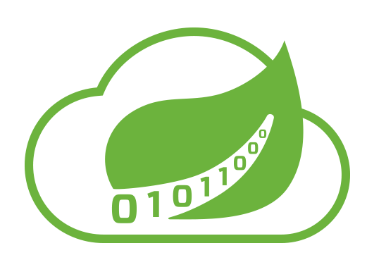
Why SCDF on Tanzu?
Spring Boot Microservices
Build production-ready Java apps
Choose from curated starters
The Spring Ecosystem
Mature, actively maintained libraries
Trusted, helpful community
Pivotal Cloud Foundry
Open source PaaS for DevOps & Ci/CD
Heavy Lifting: Elastic scale, HA, Secure
For on-premise & cross-cloud

Slide 10
Spring Cloud Data Flow Sucess Stories
Telecommunications | Data ingest, stream processing, integration with Spark and Hadoop
Real Estate Analytics | Dataflow modernization, consolidation of legacy apps onto PCF (details...)
Health Care | ETL modernization, change data capture Event stream processing, GemFire (details...)
Banking | Integration pipelines Batch and near-real-time
Insurance | Rules-engine modernization (.NET) Offload DBMS and Data Warehouse to microservices
Notes:
Telecommunications (Comcast)
Data ingest, stream processing, integration with Spark and Hadoop
Real Estate Analytics (Core Logic)
Dataflow modernization,
consolidation of legacy apps onto PCF (details...)
Health Care
(HCSC)
ETL modernization, change data capture
Event stream processing, GemFire (details...)
Banking
Integration pipelines Batch and near-real-time
Insurance (Inovalon)
Rules-engine modernization (.NET) Offload DBMS and Data Warehouse to microservices

Slide 11
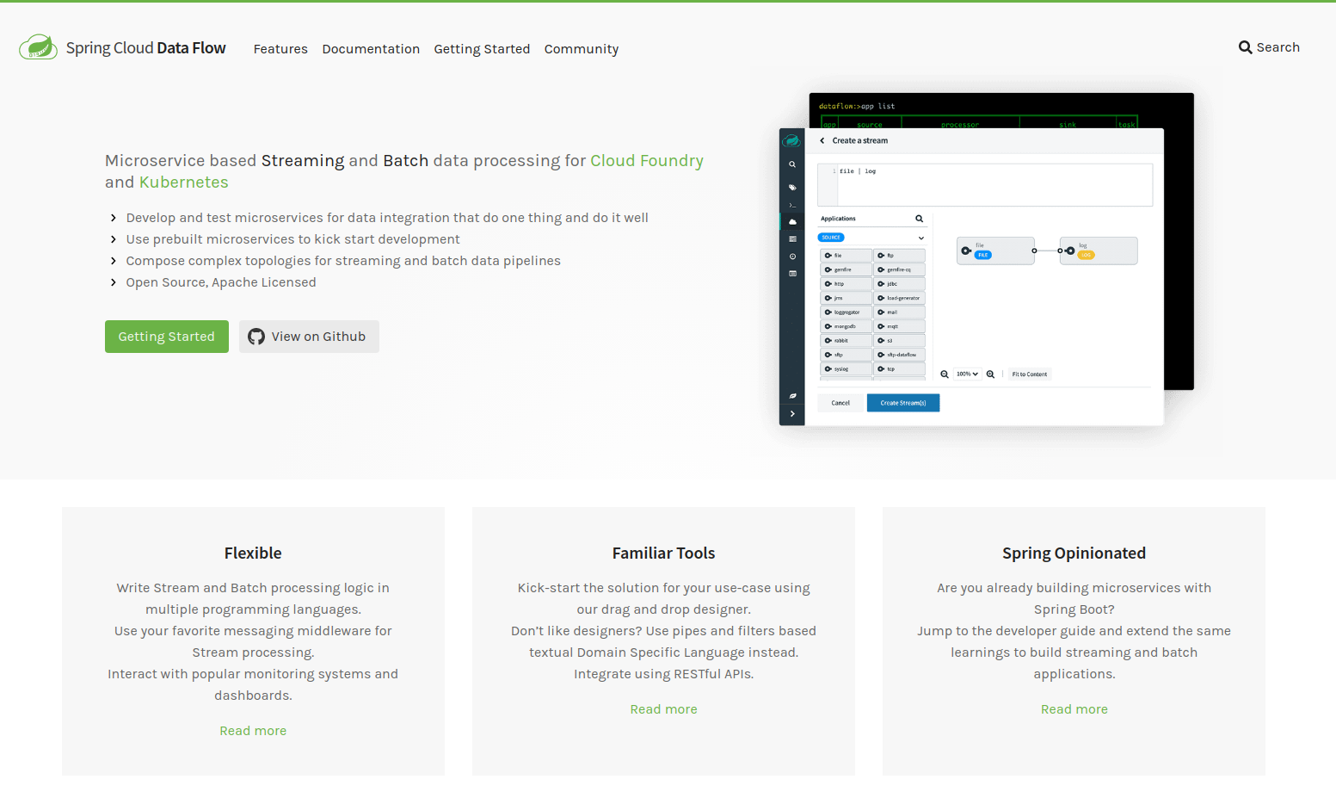
dataflow.spring.io

